Slide 1
Data Science
CSE-4077

Slide 2
About me
Haseeb Ahmad
PhD: Computer Science (Data Mining)
Beijing University of Posts and Telecommunications, Beijing, China.
2 |

Slide 3
“Data! Data! Data!” he cried impatiently. “I can’t make bricks without clay.”
Arthur Conan Doyle

Slide 4
What is Data Science and Who is Data Scientist?

Slide 5
Some possible definitions
Data science is the application of computational and statistical techniques to address or gain insight into some problem in the real world

Slide 6
Some possible definitions
Data science = statistics + data processing
+ machine learning + scientific inquiry
+ visualization + business analytics
+ big data + …

Slide 7
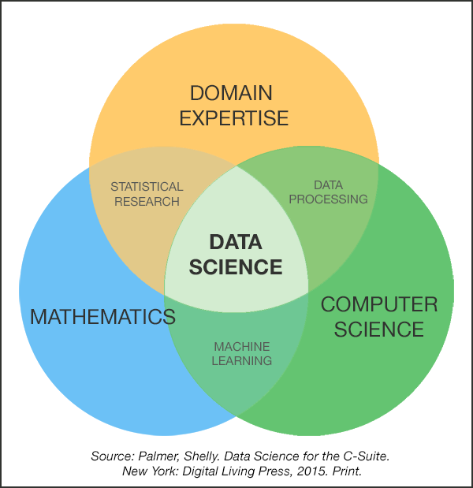
Some possible definitions

Slide 8
Data Science is a new term. But in the same sense as Columbus discovered NEW continent 1000 years ago
(c) Hector Garcia-Molina.
Professor in the Departments of Computer Science and Electrical Engineering at Stanford University

Slide 9
Fourth Paradigm of Science
Thousands of years
Empirical
Few hundreds of years
Theoretical
Last fifty years
Computational
“Query the world”
Last twenty years
eScience (Data Science)
“Download the world”

Slide 10
20th Century Innovation
- Cars - Airplanes - Power grid - Television - Air conditioning and central heating - Nuclear power - Digital computers - The internet

Slide 11
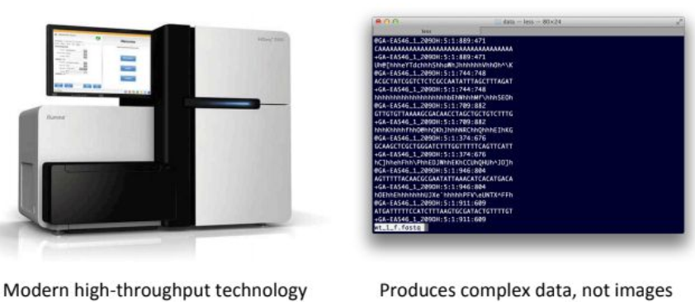
21st centaury

Slide 12
Data Science and Others
Business Intelligence
Statistics
Data(base) Management
Visualization
Machine Learning
Data Mining
Artificial Intelligence
Big Data

Slide 13
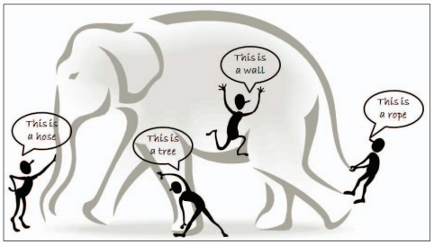
What is big data?

Slide 14
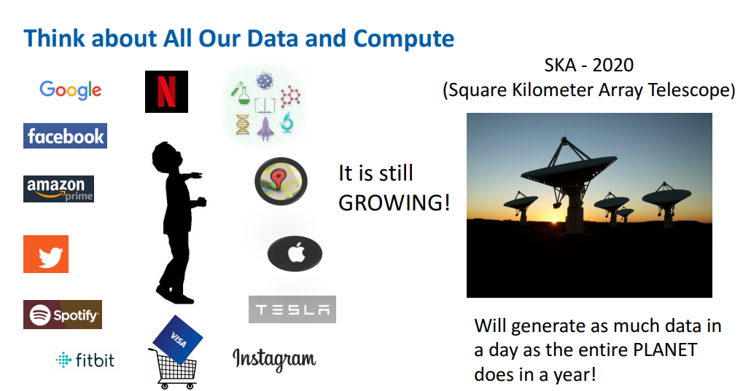

Slide 15
How big is Zetabyte (Zb)?
Terabyte: Can store 200,000 photos or mp3 songs
Petabyte: Can fit 16 Backblaze storage pods racked in two data center cabinets
Exabyte: Can fit in 2,000 cabinets within a 4-story data center of 264*900 feet
Zetabyte: Can fill 1,000 data centers covering approximately 12 ${\text{Km}}^{2}$
Zetabyte: Can fill 1,000 data centers covering approximately 12 〖"Km" 〗^2
Yottabyte: Can fill 1000,000 data centers covering approximately 10,447 ${\text{Km}}^{2}$
Yottabyte: Can fill 1000,000 data centers covering approximately 10,447 〖"Km" 〗^2

Slide 16
Data explosion
4.4 Zb (2013)
40 Zb (2020)
180 Zb (2025)

Slide 17
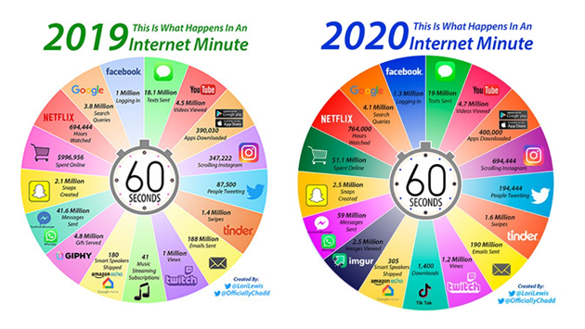
Why Big Data Keeps Getting Bigger

Slide 18
Data science is not Database!
 | Databases | Data Science
Data Value | “Precious” | “Cheap”
Data Volume | Modest | Massive
Examples | Bank records, Personnel records, Census, Medical records | Online clicks, GPS logs, Tweets, Building sensor readings
Priorities | Consistency, Error recovery, Auditability | Speed, Availability, Query richness
Structured | Strongly (Schema) | Weakly or none (Text)
Properties | Transactions, ACID* | CAP* theorem (2/3), eventual consistency
Realizations | SQL | NoSQL: MongoDB, CouchDB, Hbase, Cassandra, Riak, Memcached, Apache River, …
*ACID = Atomicity, Consistency, Isolation and Durability
*CAP = Consistency, Availability, Partition Tolerance

Slide 19
Data science is not machine learning!
Machine learning involves computation and statistics, but has traditionally been not very concerned about answering scientific questions
Machine learning has a heavy focus on fancy algorithms
… ... but sometimes the best way to solve a problem is just by visualizing the data, for instance

Slide 20
Data science is not statistics!
“Analyzing data computationally, to understand some phenomenon in the real world, you say? … that sounds an awful lot like statistics”
Statistics (at least the academic type) has evolved a lot more along the mathematical/theoretical frontier
Not many statistics courses have a lecture on e.g. web scraping, or a lot of data processing more generally
Plus, statisticians use R, while data scientists use Python ... clearly these are completely different fields

Slide 21
Data Science benefits from . . .
- Software developers are hired to produce code.
- Data Scientists are hired to produce insights.
- Genius shows in finding the right answer!!!
- Wisdom shows in avoiding the wrong answers.
- Data science (like most things) benefits more from wisdom than from genius

Slide 22
Data science is not big data!
Sometimes, in order to truly understand and answer your question, you need massive amounts of data But sometimes you don’t
Don’t create more work for yourself than you need to

Slide 23
Big Data Science Tasks
Facebook
Amazon
Google
LinkedIn
Netflix
Microsoft
. . .

Slide 24
Regular Data Science Tasks
Data analysis
What percentage of users back to our site?
Which products usually bought together?
Modeling/statistics
How many cars we are going to sell next year?
Which city is better for opening new office?
Engineering/prototyping
Product to use a prediction model
Visualization of analytics

Slide 25
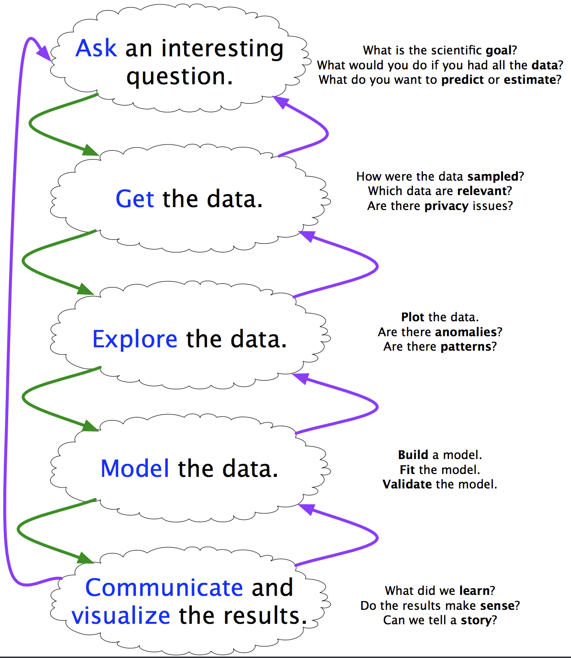
What Data Science is!

Slide 26

Human
VS.
Machine

Slide 27
Human vs. Machine
Human
Naturally can work with small amount of data
Have a knowledge about domain
Good image recognition
Machines
Can make intensive computations
Knows only numbers and strings (well, actually only numbers)

Slide 28
A data scientist is the adult version of the kid who can’t stop asking “Why?”
(c) Russ Thompson
Senior Research Scientist at Alexa

Slide 29
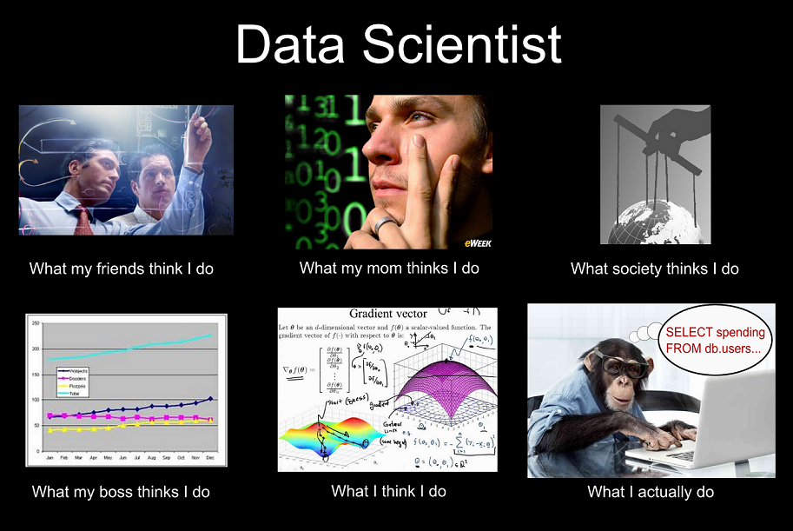

Slide 30
Who is Data Scientist?
Scientist
Someone who find new discoveries
Make a hypothesis
Investigate that hypothesis
Data Scientist
Do the same with data
Look for meaning, knowledge in the data
Answering questions and rely on data

Slide 31

Who is Data Scientist?
“A data scientist is someone who knows more statistics than a computer scientist and more computer science than a statistician.”
- Josh Blumenstock
“Data Scientist = statistician + programmer + coach +
storyteller + artist”
- Shlomo Aragmon

Slide 32
What data scientists do?
The good data scientist develops a curiosity about the domain/application they are working in.
- They talk shop with the people whose data they are working on.
- They read different news, articles and updates to get a broader perspective on the world.
- They keep on searching for open research areas in their field.

Slide 33

Specialist Traditional Data Science Team
Data Scientist (DS) – Prepares data, engineers features, most valuable skill: training models.
Data Engineer (DE) – Data acquisition focus. Build data pipelines.
Data Analyst (DA) – Assist DS with data preparation
Application architect (AA) – Design complete solution; deploy and maintain models in production

Slide 34
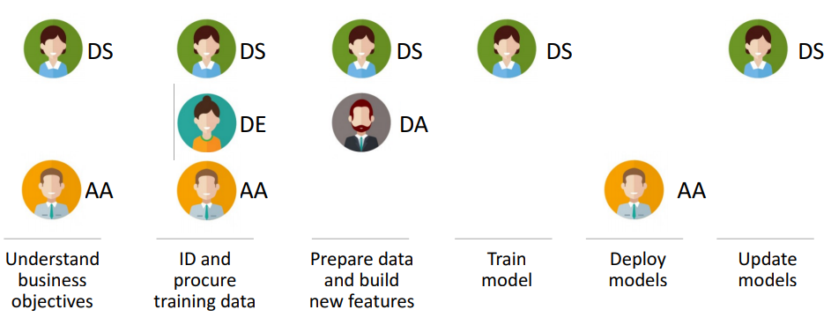
Typical Data Science Project

Slide 35
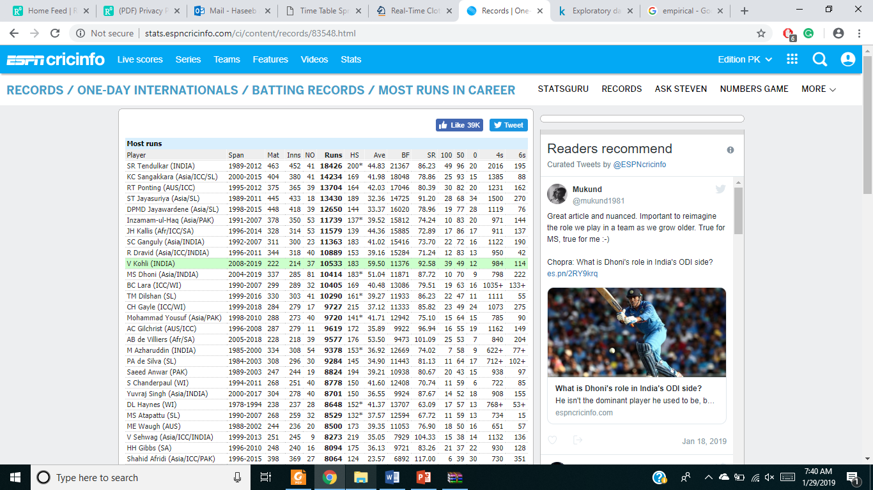
http://stats.espncricinfo.com

Slide 36
Cricket Questions
- Who are the rising stars?
Does the venue matters for winning?
- What is the trajectory of player’s performances as they mature and age?
- To what extent does batting performance correlate with the position played?
- Do left-handed people have shorter lifespans than right-handers?

Slide 37
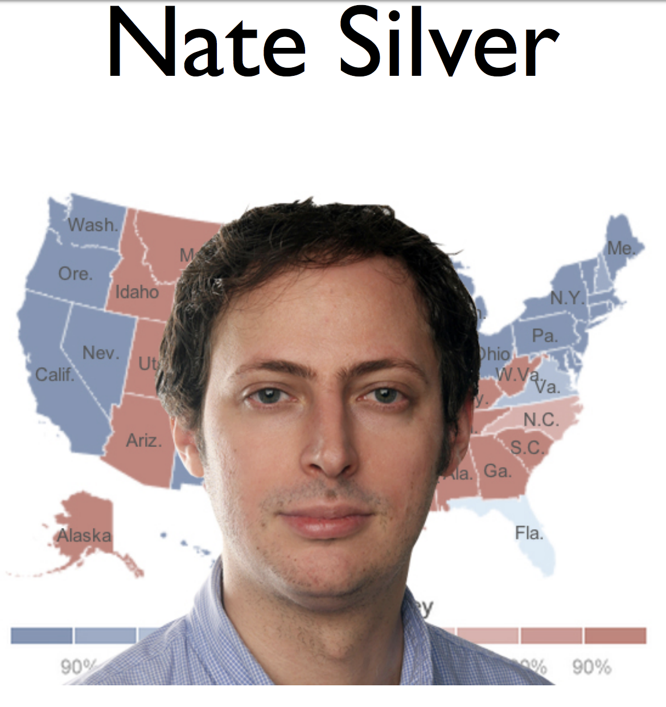
Who is Data Scientist?

Slide 38
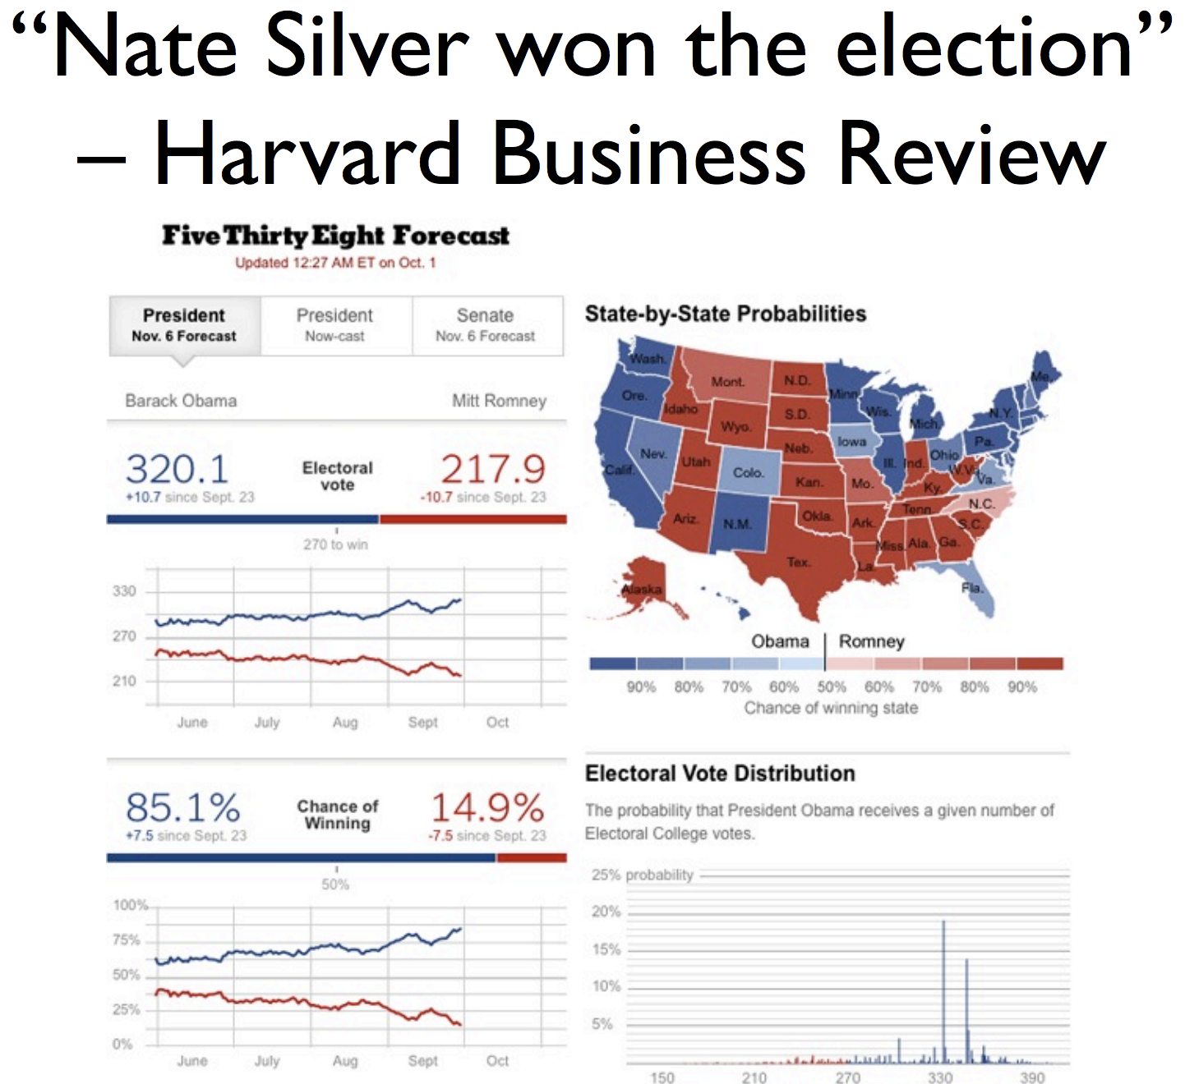
Who is Data Scientist?

Slide 39
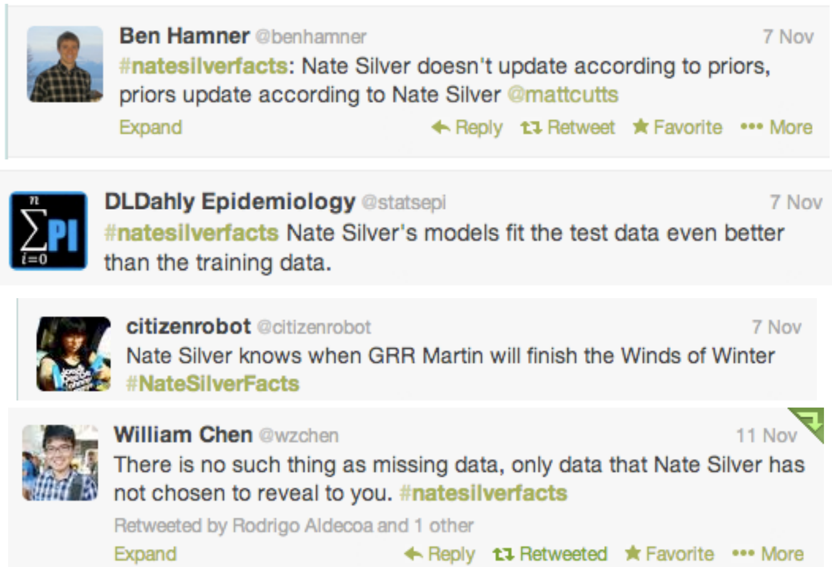
#NateSilverFacts?

Slide 40
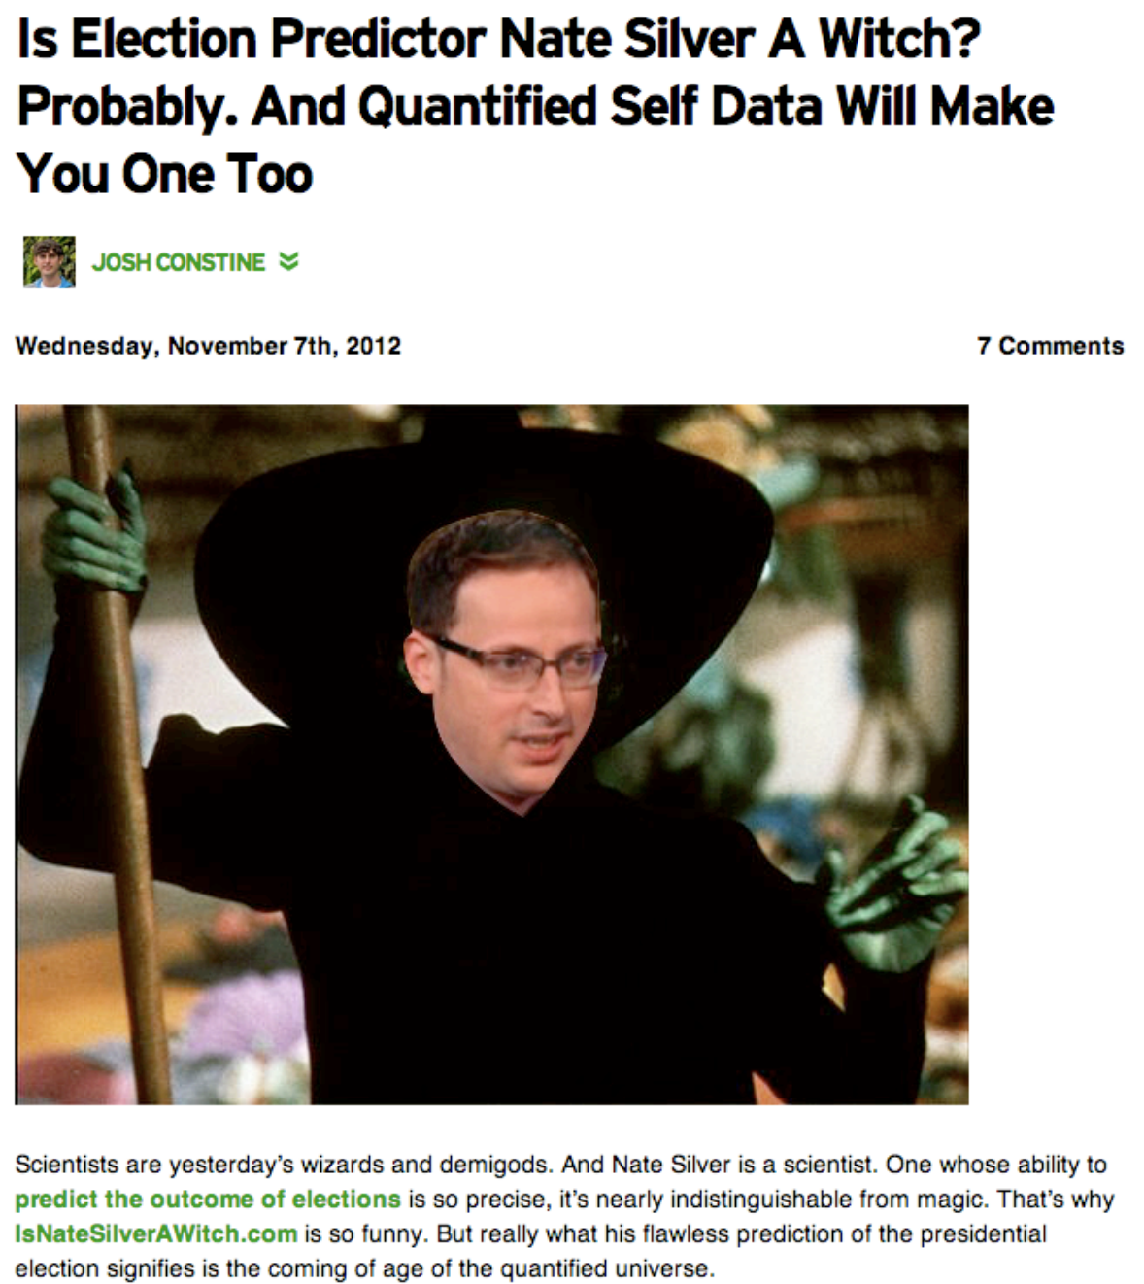
#NateSilverFacts?

Slide 41

Data Scientist is the s***est job of 21st century (c) Harvard Business Review
Oh, Really?

Slide 42
Data Science Applications
Transaction Databases → Recommender systems (NetFlix), Fraud Detection (Security and Privacy)
Wireless Sensor Data → Smart Home, Real-time Monitoring, Internet of Things
Text Data, Social Media Data → Product Review and Consumer Satisfaction (Facebook, Twitter, LinkedIn), E-discovery
Software Log Data → Automatic Trouble Shooting (Splunk)
Genotype and Phenotype Data → Epic, 23andme, Patient-Centered Care, Personalized Medicine

Slide 43
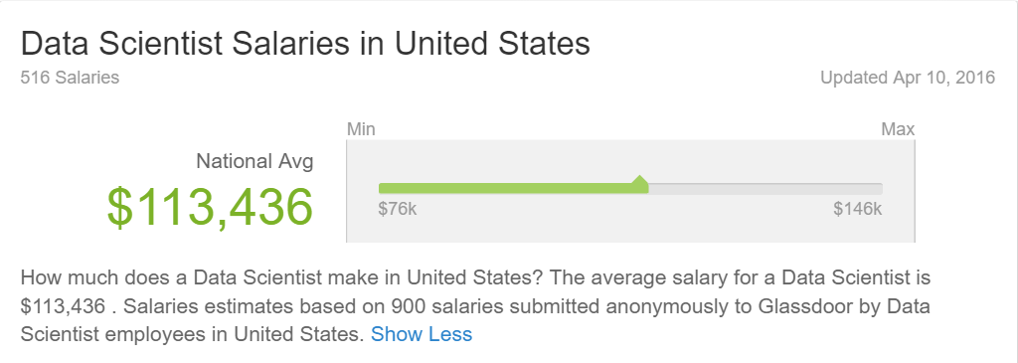
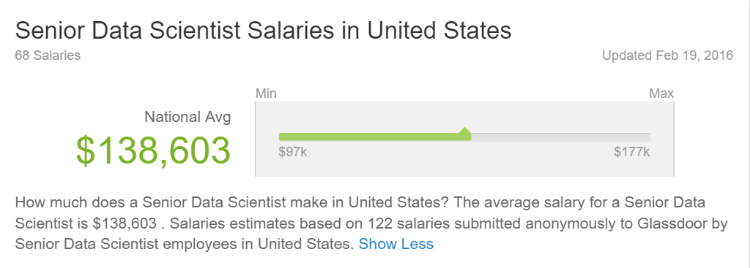

Slide 44
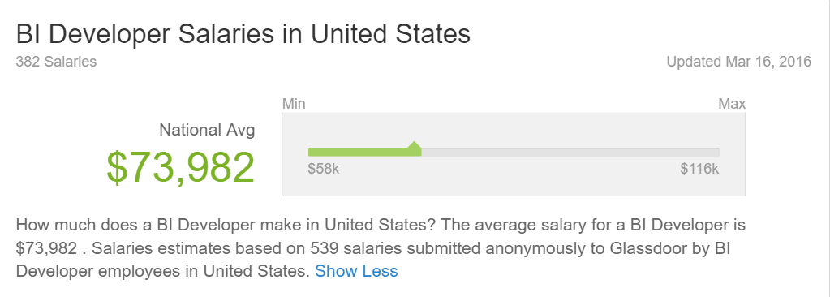
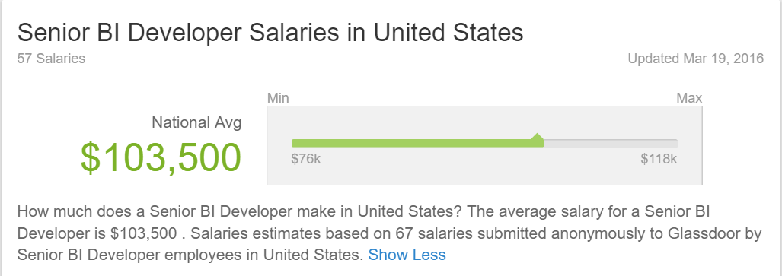

Slide 45
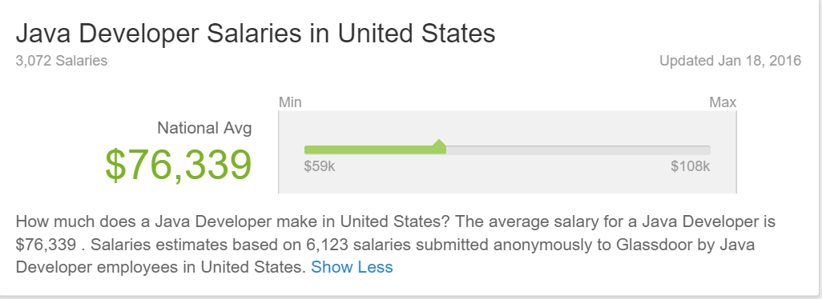
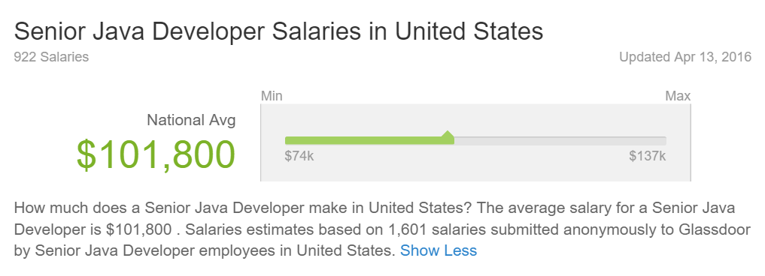

Slide 46
“By 2018, the US could face a shortage of up to 190,000 workers with analytical skills”
McKinsey Global Institute
“The s*** job in the next 10 years will be statisticians.” Data Scientists
Hal Varian, Prof. Emeritus UC
Berkeley Chief Economist, Google

Slide 47
Data Dilemma
Cost vs. Value
How much Value can I extract from the data?
How much it will cost to me to store that data?
Big Data
No individual record is particularly valuable
Having every record is incredibly valuable

Slide 48
Data Science Project
Should have a goal (aka Problem)
How many customers will buy this car next month?
Which capacity should I reserve for my database growth? (well, I’ve just discovered that my everyday job become a Data Science problem)
In which city should I open the office?
Result
Prototype of a working algorithm
Deploy prediction model to use on a daily basis
Visualize trends
Find hidden correlations between parameters

Slide 49
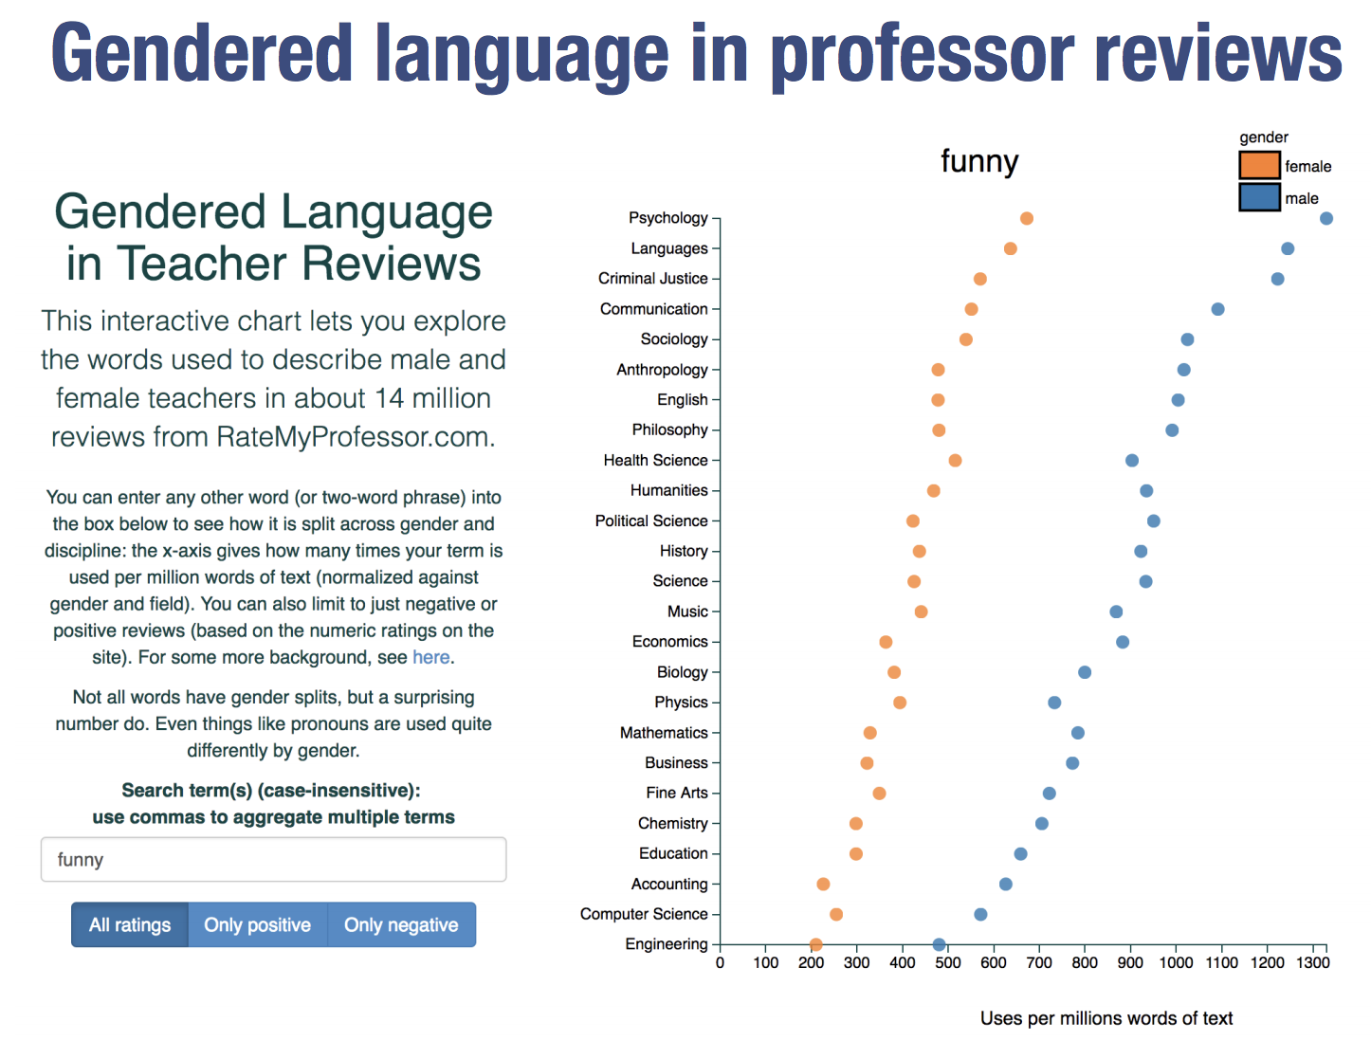
Data Science Example
http://benschmidt.org/profGender/

Slide 50
Obligatory quote
The greatest value of a picture is when it forces us to notice what we never expected to see.
-John Tukey

Slide 51
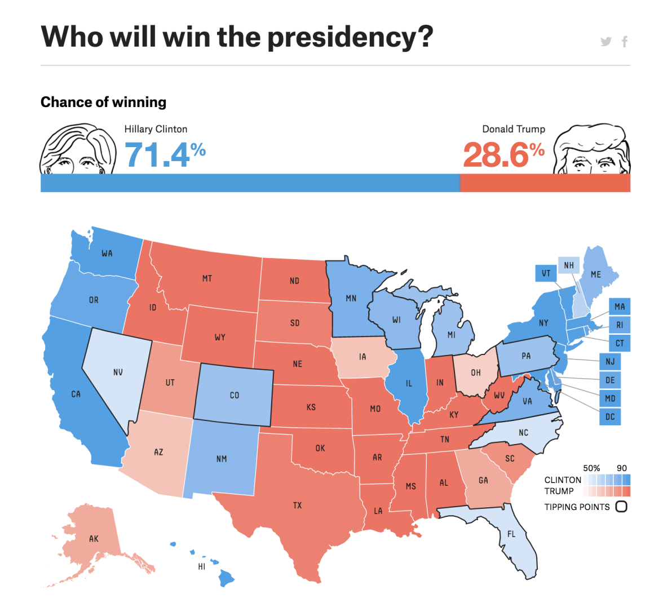
FiveThirtyEight
https://projects.fivethirtyeight.com/2016-election-forecast/

Slide 52
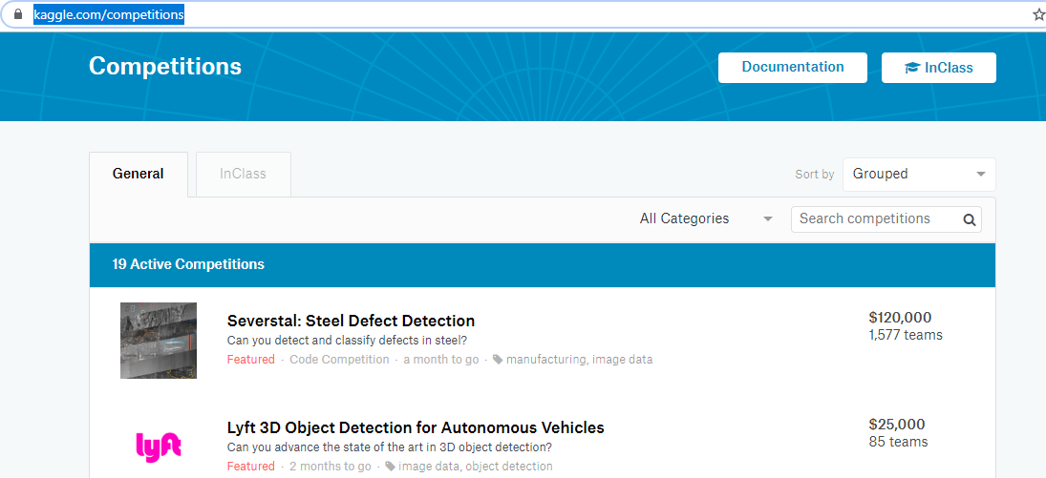
Challenge!
https://www.kaggle.com/competitions

Slide 53
Learning objectives of this course?
After taking this course, you should…
… understand the full data science pipeline, and be familiar with programming tools to accomplish the different portions
... be able to collect data from unstructured sources and store it using appropriate structure such as relational databases, graphs, matrices, etc.
... know to explore and visualize your data
... be able to analyze your data rigorously using a variety of statistical and machine learning approaches

Slide 54
Topics covered (subject to change)
Data collection and management: relational data, matrices and vectors, graphs and networks, free text processing, geographical data
Statistical modeling and machine learning: linear and nonlinear classification and regression, regularization, data cleaning, hypothesis testing, kernel methods and SVMs, boosting, clustering, dimensionality reduction, recommender systems, deep learning, probabilistic models, scalable ML
Visualization: basic visualization and data exploration, data presentation and interactivity

Slide 55
Course Facets (subject to change)
data munging/scraping/sampling/cleaning in order to get an informative, manageable data set; •
data storage and management in order to be able to access data - especially big data - quickly and reliably during subsequent analysis;
exploratory data analysis to generate hypotheses and intuition about the data;
prediction based on statistical tools such as regression, classification, and clustering; and
communication of results through visualization, stories, and interpretable summaries.

Slide 56
Class project
A major component of the class: goal is to take a real-world domain that you are interested in, and apply data science methodologies to gain insight into the domain
Work to be done in groups of 3 students
Final report will be a covering the analysis of your data, including code and visual results
Presentation can be asked (in lieu of final)
Class projects must be focused on some real data problem (ideally one that you collect yourself), not an already-curated data set

Slide 57
Where to Learn?
University
Online Resources
Coursera
Edx
Etc.
Books

Slide 58
Student well-being
Courses like this one are stressful environments
In my experience, most academic integrity violations are the product of these environments and decisions made out of desperation
Please don’t let it get to this point (or potentially much worse)
Don’t sacrifice quality of life for this course: still make time to sleep, eat well, exercise

Slide 59
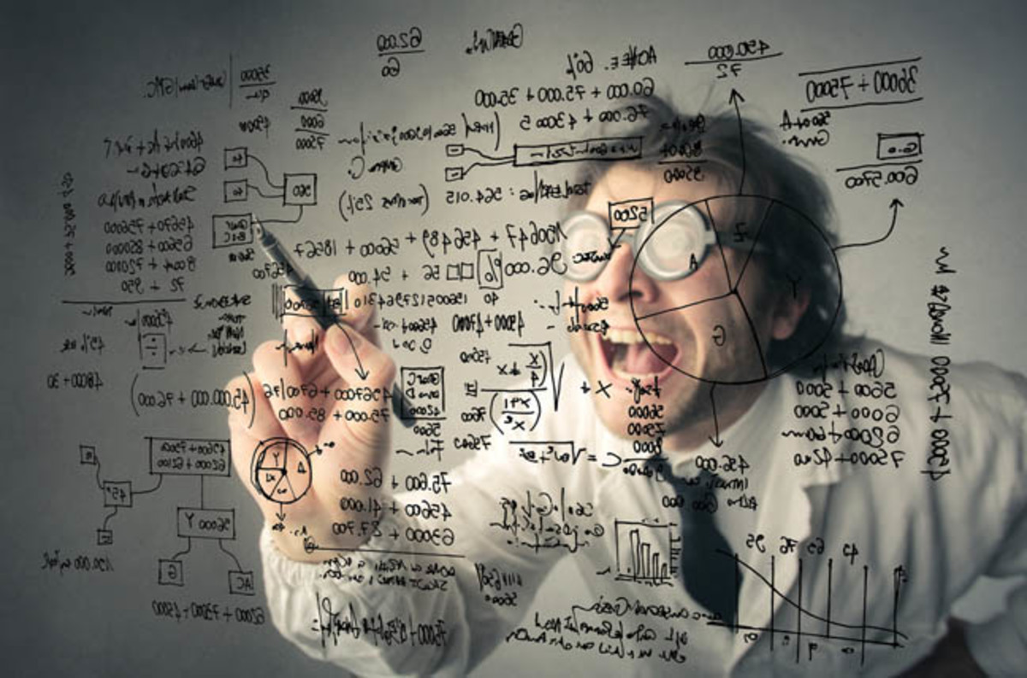
Let’s do some Data Science

Slide 60
Summary
What is Data Science?
Who is Data Scientist?
Discover info about Data Science using Data Science

Slide 61
Resources
https://www.anaconda.com/download/
The Fourth Paradigm
Cloudera: Training A New Generation Of Data Scientists
The Future of Data Science - Data Science @ Stanford
Coursera: Data Manipulation at Scale
Coursera: Machine Learning
Understanding Data Science and Why It’s So Important
Data Scientist: The S***est Job of the 21st Century

Slide 62
Thank you!
Email: haseeb_ad@hotmail.com
Researchgate: https://www.researchgate.net/profile/Haseeb_Ahmad3

